Slide 1


Introduction to
Robotic Process Automation
Bot For Latest News Updates And Fact
220701089
Harshni P
Mrs J Jinu Sophia
Assistant Professor (SG)

Slide 2
Abstract
This UiPath automation bot is designed to simplify the process of obtaining and sharing the latest news updates. Users provide a specific search topic and a Gmail ID as input. The bot then searches for the most recent and relevant news articles on the given topic, extracts their URLs, and sends the information directly to the specified email address. By combining advanced web scraping techniques with email automation, this project offers a seamless and efficient solution for staying informed in real-time.

Slide 3
Need for the Proposed System
In today's fast-paced world, staying updated with the latest information is essential, but manually searching for news on specific topics can be time-consuming and inefficient. The proposed system addresses this need by automating the process of gathering and delivering news updates. It ensures users receive real-time, relevant information without the hassle of constant searching. By integrating advanced automation techniques, this system enhances productivity, saves time, and delivers streamlined access to the latest news directly to users’ email inboxes.

Slide 4
Advantages of the Proposed System
Time-Saving: Automates the process of searching and filtering news, saving users significant time.
Convenience: Delivers curated, topic-specific updates directly to users' Gmail accounts.
Real-Time Updates: Ensures users receive the latest and most relevant news as soon as it becomes available.
User-Friendly: Simplifies access to information with minimal user input, making it easy to use.
Customization: Allows users to focus on specific topics of interest.
Efficiency: Combines web scraping and email automation for seamless delivery.

Slide 5
Literature Survey
Paper 1:UiPath News Update Bot
Advantages :
Automation Efficiency
Personalized Results
Seamless Communication
Disadvantages:
Dependency on Internet Connectivity
Gmail SMTP Limitations
Error Handling Complexity

Slide 6
Main Objective
The main objective of the UiPath bot is to automate the process of retrieving the latest news based on a specified topic. The bot takes two inputs: a search topic and a Gmail ID. It searches for news articles related to the topic, extracting relevant information such as article titles and URLs. After gathering the latest news, the bot formats the data and sends it via email to the provided Gmail ID. This automation saves time by providing users with up-to-date news without manual searching, ensuring efficient, timely, and relevant information delivery directly to their inbox.

Slide 7
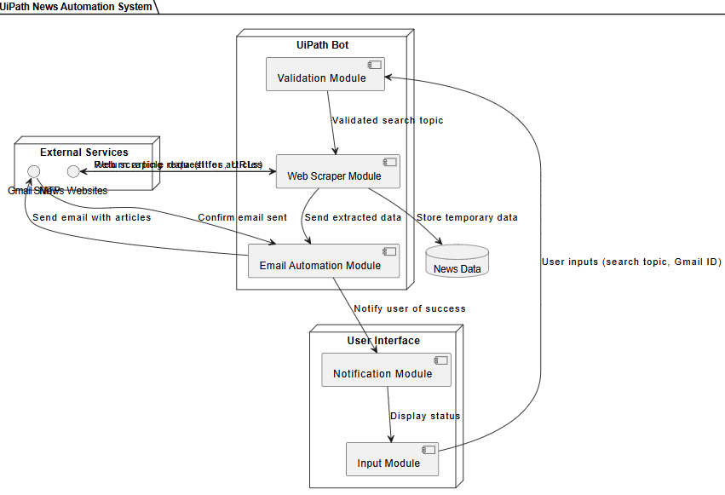
Architecture

Slide 8
System Requirements
Hardware Requirements:
The system requires a minimum of Intel Core i3 processor, 4 GB RAM, and 1 GB of disk space. For better performance, an Intel Core i5 processor and 8 GB RAM are recommended. A stable internet connection is essential for web scraping, API requests, and email communication.
Software Requirements:
The system requires Windows 10 (64-bit) or higher, UiPath Studio (Community or Enterprise), and .NET Framework 4.6+. Browsers like Google Chrome or Microsoft Edge are needed for web scraping. Gmail with SMTP enabled is required for email communication, along with relevant UiPath packages like Mail and WebAPI Activities.

Slide 9
Functional Description
Input Collection: The bot prompts the user to input a search topic and a Gmail ID. These inputs serve as the basis for news retrieval and email delivery.
News Retrieval: Using web scraping or API integration (e.g., NewsAPI), the bot searches for articles related to the input topic. It extracts key information, such as article titles and URLs, from reliable news sources.
Data Processing: The bot organizes the extracted news data into a structured format, making it suitable for email delivery.Email
Dispatch: The bot uses Gmail's SMTP server to send the curated news, including titles and URLs, to the specified Gmail ID.
Error Handling: The bot incorporates error-handling mechanisms to manage scenarios like incorrect inputs, internet issues, or API failures.

Slide 10
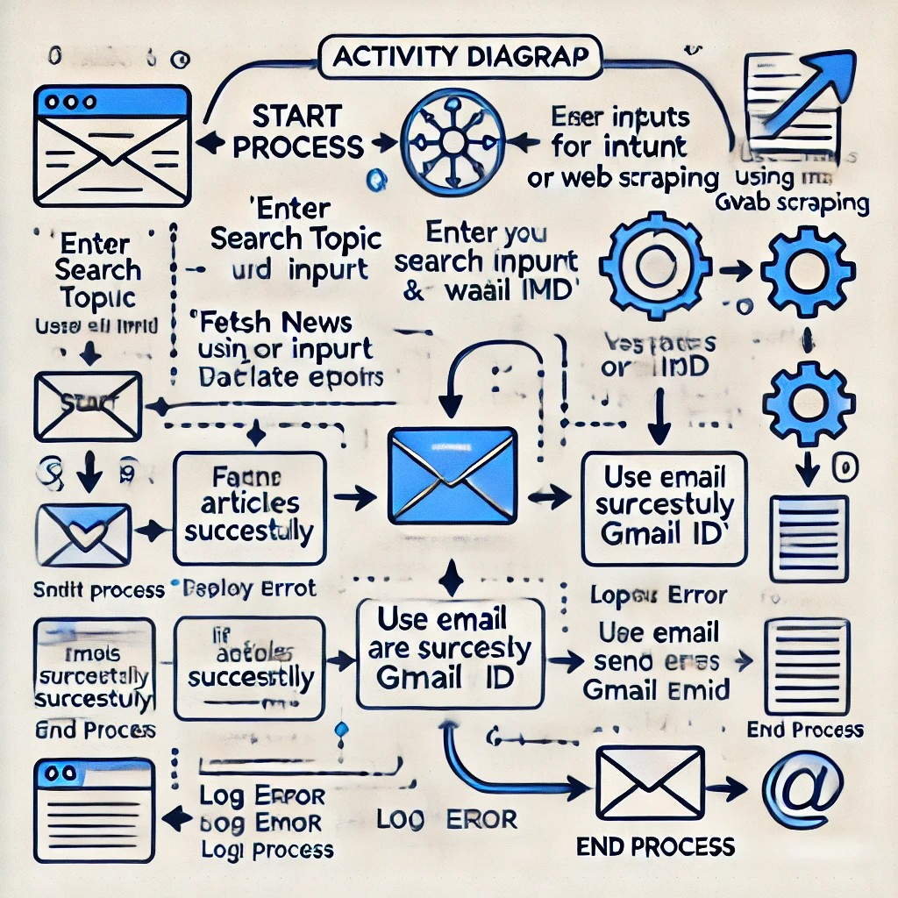
Data Flow Diagram

Slide 11
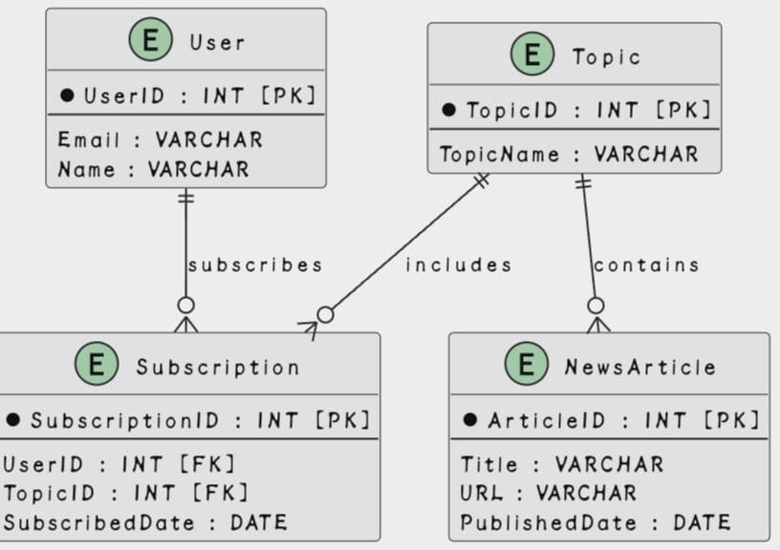
Table Design

Slide 12
Process Design
Input Collection: Start Process Prompt for Search Topic and Gmail ID
Input Validation : Check if Search Topic is non-empty Validate Gmail ID format If invalid, terminate process.
Fetch News :Use web scraping or APIs to gather articles.Extract Title, URL, and other relevant details
Process Data :Format data into a structured table or plain text.
Send Email :Use SMTP to send the news to the user's Gmail ID.
Error Handling :Retry failed steps or log errors
End Process :Notify the user about success or failure.

Slide 13
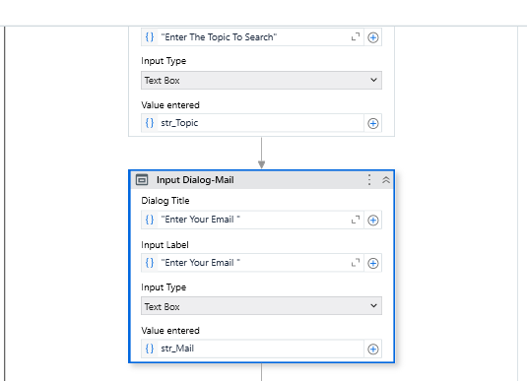
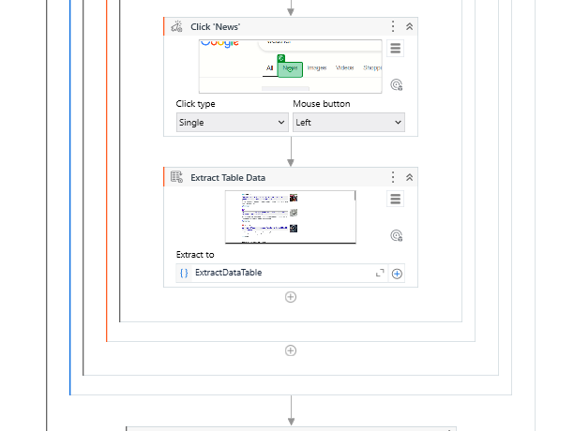
Implementation

Slide 14
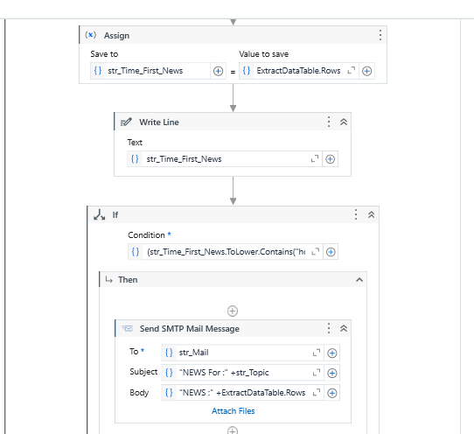
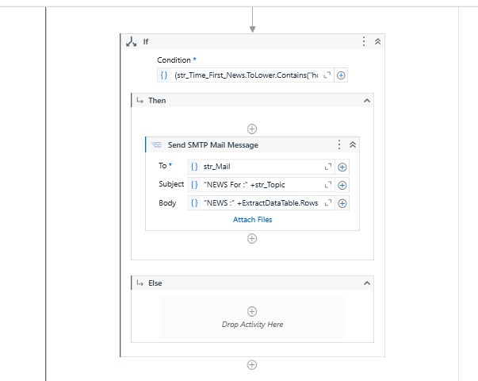

Slide 15
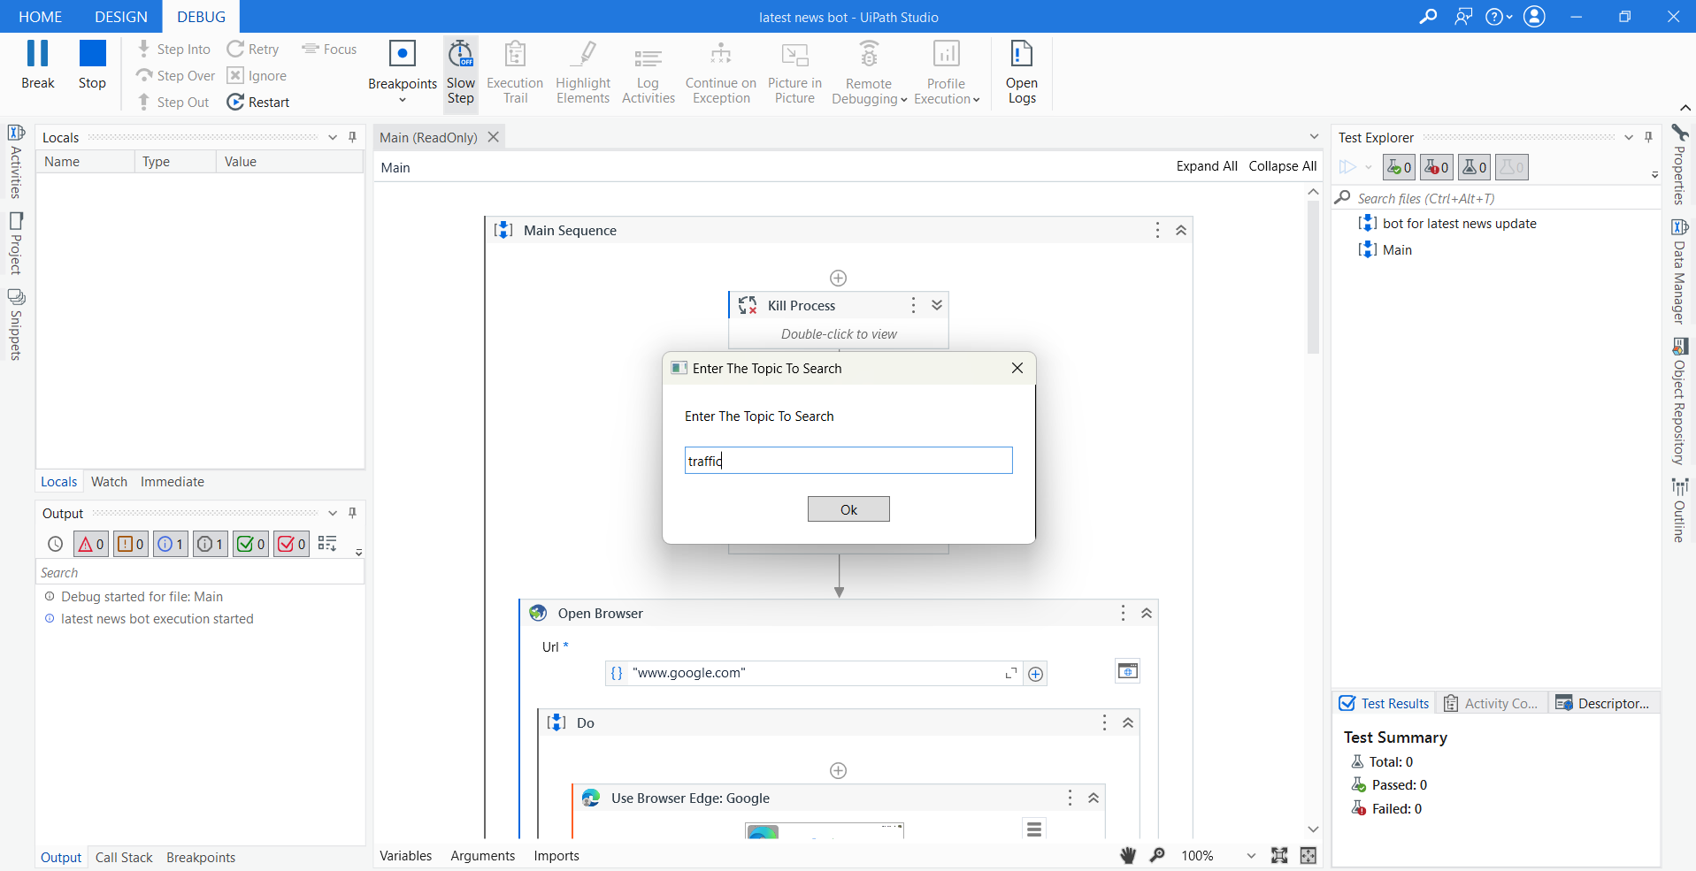
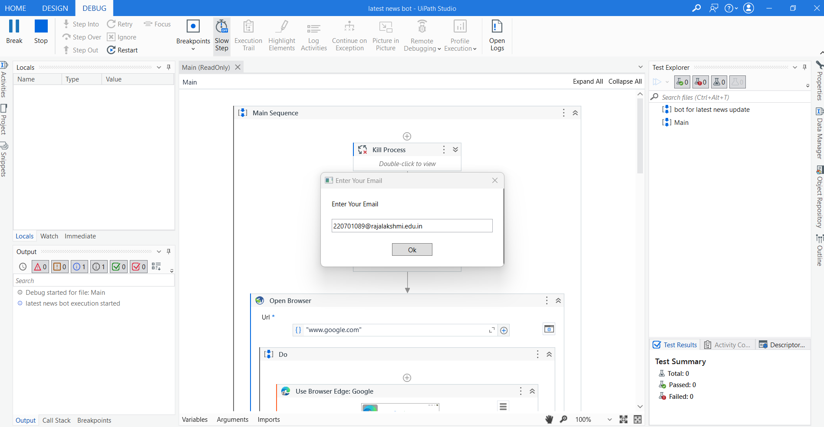
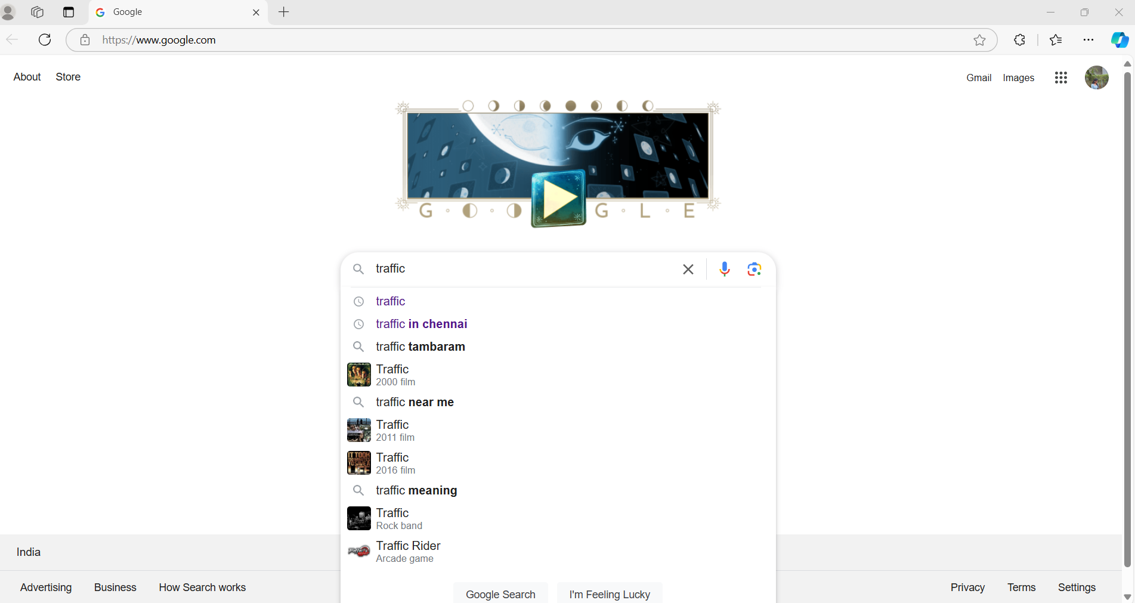
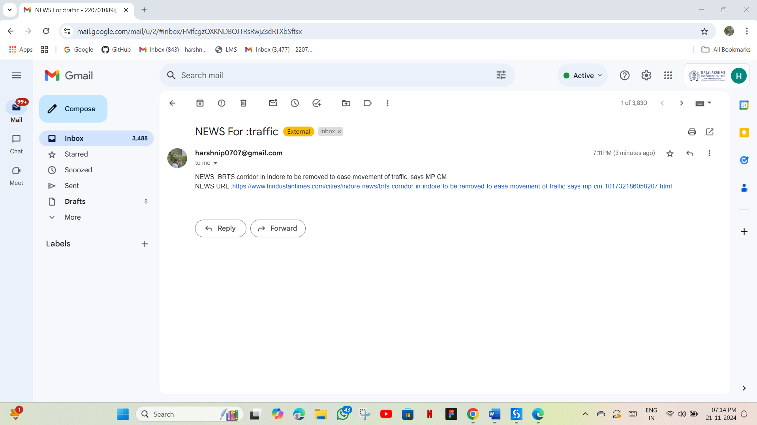
Testing

Slide 16
Conclusions
The UiPath automation bot designed for extracting and sharing the latest news provides an effective solution for streamlining information access. By combining web scraping with email automation, this project allows users to stay informed effortlessly and in real-time. The automated process reduces manual work, ensuring users receive timely, relevant updates directly in their inboxes with minimal interaction.

Slide 17
Future Enhancement
Description 1
Description 2

Slide 18
IEEE Paper
Khan, S. P., & Khan, R. (2023). RPA Using UiPATH in the Context of Next Generation Automation. Robotic Process Automation, 395-422.
Lohynska, T. (2023). Developing an AI-Driven RPA Bot Using UiPath and OpenAI Platforms to Automate and Improve Internal Communication at Lunatec: In Cooperation with Lunatec GmbH (Master's thesis, Universidade NOVA de Lisboa (Portugal)).

Slide 19
References
Kuppusamy, Palanivel & Joseph K, Suresh. (2020). Robotic Process Automation to Latest News. 3775.
2. Patil, Dr & Mane, Vinod & Patil, Dr. (2019) News Generator Automation (Rpa). International Journal of Innovative Technology and Exploring Engineering. 8. 3757-3760. 10.35940/ijitee.K2148.0981119.

Slide 20
Queries

Slide 21
Demonstration

Slide 22
Thank You

